Slide 1
James Otieno Ouma

Slide 2
Project Overview
Introduction: This project explores aviation accident records from the National Transportation Safety Board (NTSB) for the period 1962 to 2022.
Goal: To derive data-driven insights and recommend the safest aircraft types for a new business expanding into aviation.
Tools used: Python (Pandas, Matplotlib, Seaborn), Tableau, Git, Jupyter Notebook
Objectives:
Analyze aviation accidents to determine trends and patterns
Identify top and least involved aircraft types in accidents
Explore injury outcomes and identify high-risk cases
Provide safety-driven business recommendations for aircraft investment

Slide 3
Dataset Overview and Cleaning
Source: National Transportation Safety Board (NTSB)
File: Aviation_Data.csvTime
Period: 1962–2022
Key Columns: Accident Number, Event Date, Aircraft Make, Injury Severity, Total Fatal Injuries, Total Serious Injuries, Total UninjuredLatitude, Longitude
Exploratory Data Analysis:
Loaded dataset and dropped missing/irrelevant columns
Cleaned and converted Event Date to datetime
Created new columns like Year for trend analysis
Analyzed aircraft types, injury severity, and yearly trends
Created visualizations in Tableau

Slide 4
Insights and Recommendations
Key Insights Summary:
Small training and private-use aircraft have higher accident rates
Fatal accidents are many in bidder planes compared to smaller ones like Cessna.
Smaller planes are prone to accidents compared to bigger ones
Recent years show reduced accident trends possible due to advancement in Technology
Recommendations:
Invest in Larger Aircraft Models
Avoid Light Aircraft for Passenger Business
Review route georaphy

Slide 5
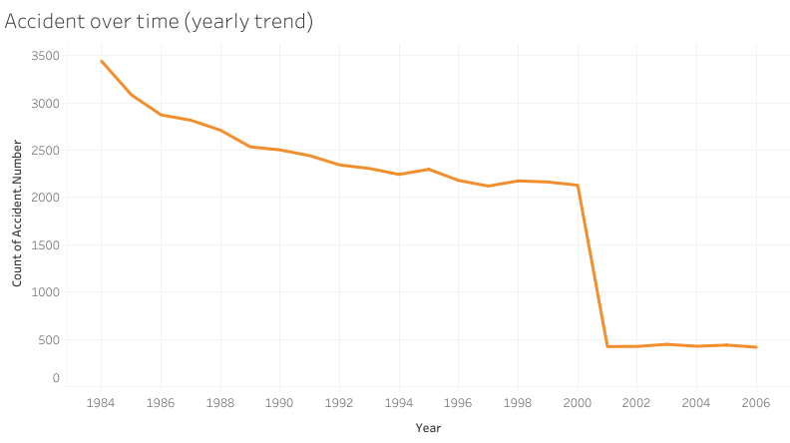

Slide 6
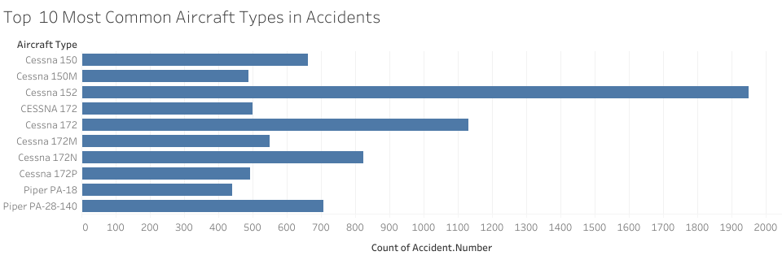

Slide 7
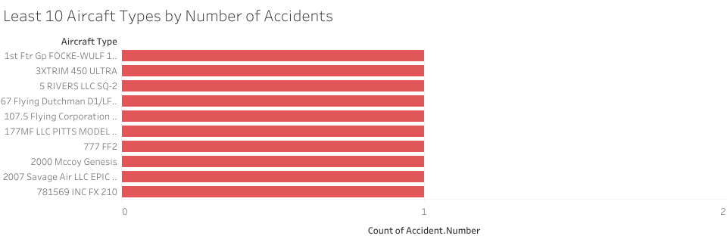

Slide 8
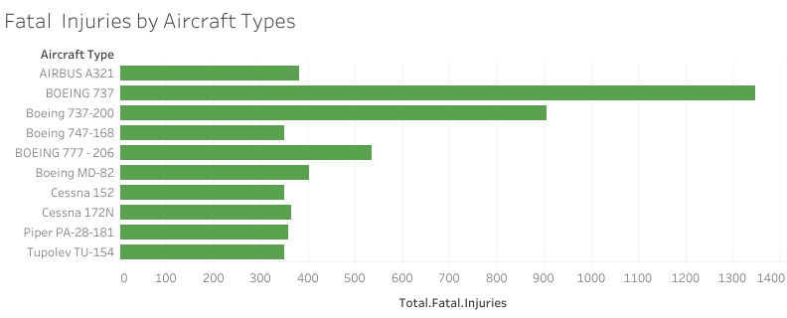

Slide 9
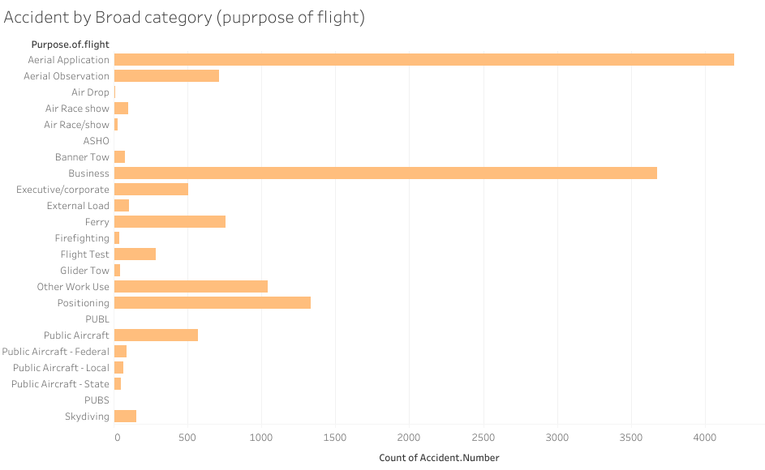

Slide 10
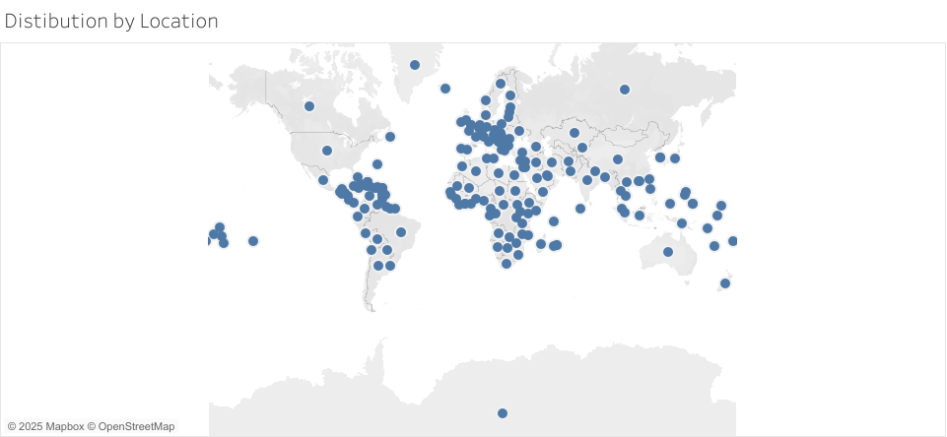

Slide 11
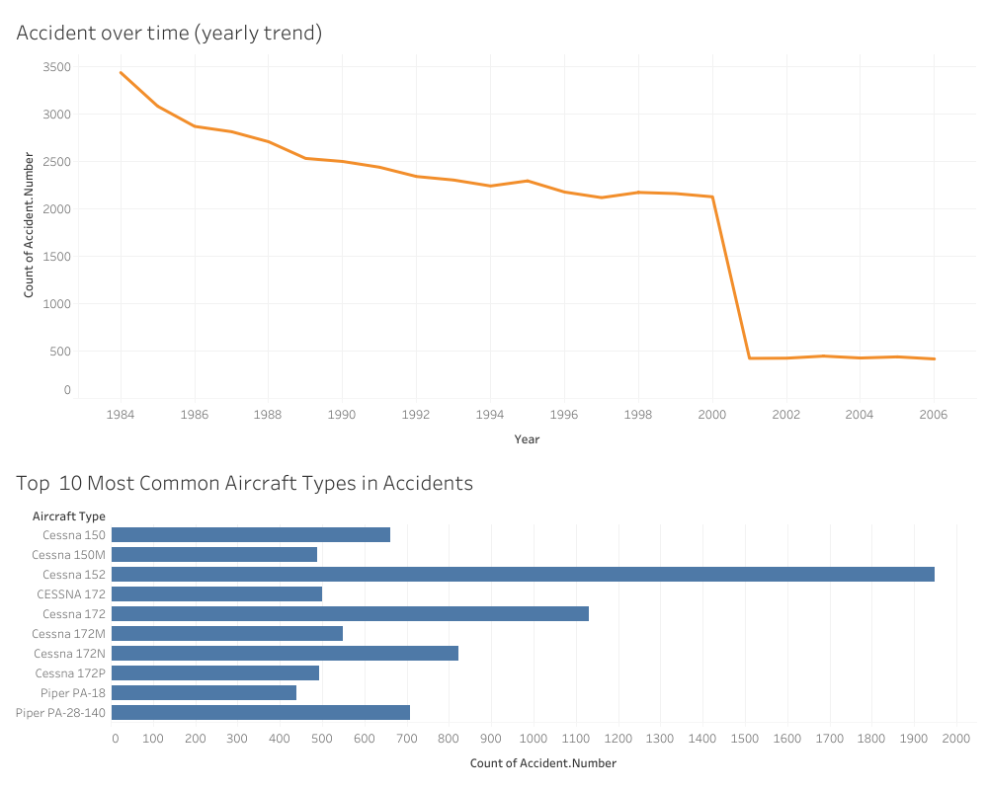

Slide 12
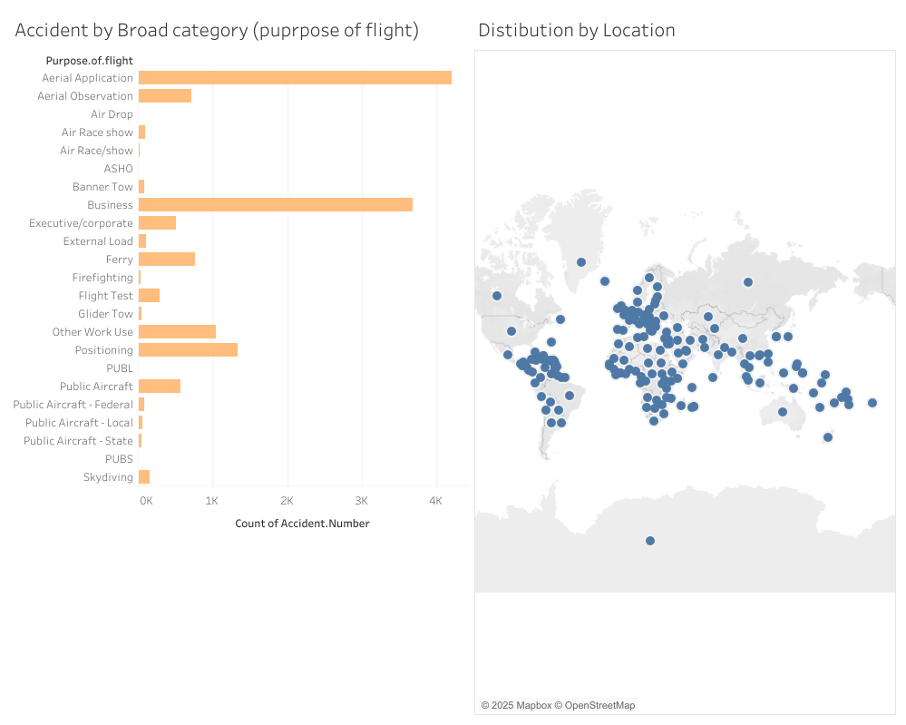

Slide 13
